Slide 1
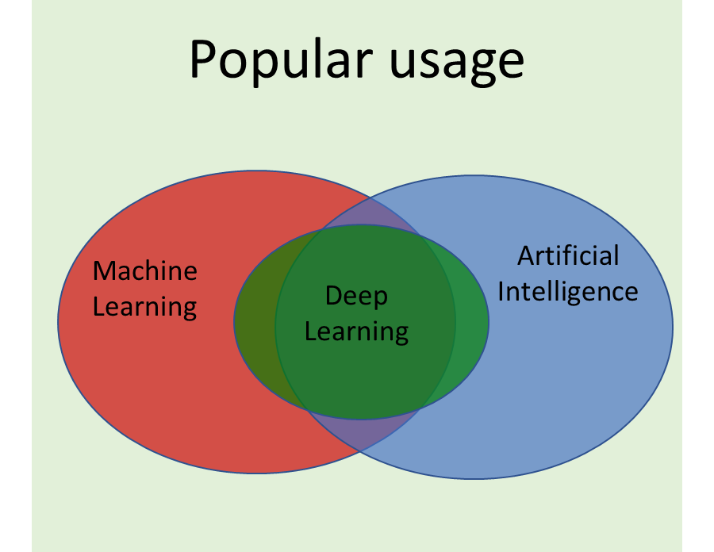
Popular usage
Academic usage
Artificial Intelligence
Machine
Learning
Artificial
Intelligence
Machine Learning
Deep
Learning
Deep
Learning

